Slide 1


SENTIMENT ANALYSIS
TEAM NAME: NEURAL NAVIGATORS
Supervisor: DR. OLIVIER BOISARD
Team Members:
MD ABDUL MUKTADIR Matriculation Number: 2624905
MITHILA DATTA Matriculation Number: 2453558
BHARATH DATTATRAIAH Matriculation Number: 2935898
PRITESH SONI Matriculation Number: 2285328
SHRADDHA MOHANTY Matriculation Number: 2963938
ZIZHAO GUO Matriculation Number: 2801964
Date: 10.02.2025

Slide 2







PRITESH SONI
PRODUCT OWNER & FRONTEND
BHARATH DATTATRAIAH
SCRUM MASTER & DEVELOPER
ZIZHAO GUO
BACKEND DEVELOPER
Dr. OLIVIER BOISARD
PROJECT SUPERVISOR
MD ABDUL MUKTADIR
BACKEND DEVELOPER
MITHILA DATTA DEVELOPER/ENGINEER
SHRADDHA MOHANTY
DEVELOPER/ENGINEER

Slide 3

TEAM WORKFLOW
Approach: Agile methodology.
Tools: Jira for task management, Teams and Google Meet for collaboration.
WEEKLY MEETINGS :
THURSDAY , 20:00

Slide 4


OUTLINE
Problem Statement
Solution
Users
Technology Stack
Success Criteria
Demo
Data Processing Pipeline
Challenges and Constraints
Future Improvements
Conclusion

Slide 5
Story Time

Slide 6


PROBLEM STATEMENT
DIFFICULT
Insights into specific aspects like quality or delivery are hard to gather
TIME CONSUMING
Time consuming activity to analyse the reviews manually
HIGH COST
Loss of productivity costing businesses

Slide 7

CHALLENGES:
Business owners don’t have time to analyze all customer reviews.
IMPACT:
Customer feedback are hard to get which leads to missed opportunities.

Slide 8


ONE SOLUTION TO RULE THEM ALL
Solution To
-Neural Insight

Slide 9
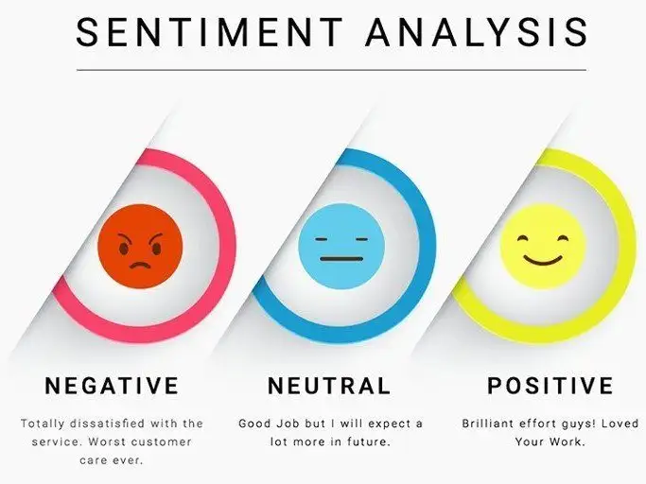

SENTIMENT ANALYSIS
9
Sentiment analysis, also known as opinion mining, involves analyzing and classifying opinions, emotions, or attitudes expressed in written language into categories like positive, negative, or neutral.

Slide 10

SENTIMENT ANALYSIS OVERVIEW
Aspect-Based Sentiment Analysis: Identify sentiments for specific review aspects.
Output: Scores for Service, Quality, Price, Delivery, Packaging.

Slide 11

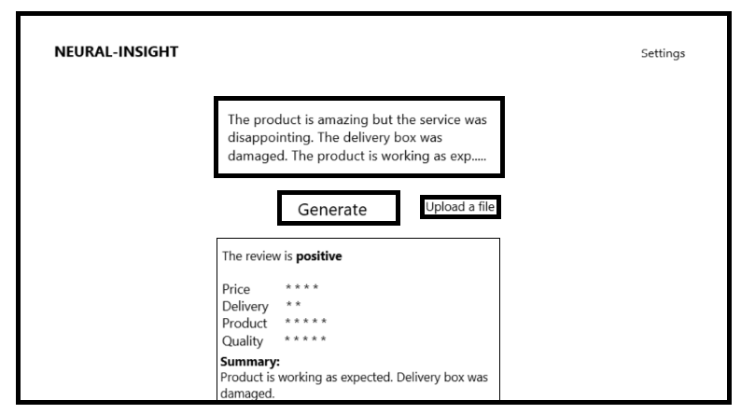

Solution
Overview:
Perform sentiment analysis to classify reviews into predefined aspects: Service, Quality, Price, Delivery, Packaging.
Use visual dashboards to present insights.
Outcome: Efficient decision-making with actionable insights.

Slide 12


Slide 13


Slide 14



TARGET USERS
Primary Users: Retailers, Business Owners.
Secondary Users: Marketing teams, product managers.
Usage: Insights for improving operations and customer satisfaction.

Slide 15









TECHNOLOGY STACK
Project Management: JIRA, Teams and GitHub
Programming Languages: Python, TypeScript.
Frontend Framework: AngularJS.
Backend Framework: Flask.
Database: MongoDB.
Visualization Library: Apex Charts.
OpenAI API: GPT-4o

Slide 16

FEATURE 1: ASPECT BASED SENTIMENT ANALYSIS
This module examines customer reviews to extract opinions on individual product attributes by evaluating sentiments related to various aspects.

Slide 17

FEATURE 2: REVIEW SUMMARIZATION
A section that generate a brief summary of the reviews, evaluating products selling performance and give suggestions for users.

Slide 18
ADVANTAGES
18
DEEPER INSIGHTS
Helps you understand your consumer
COST SAVINGS
Reduce time and therefore expenses
EASY TO USE
With just a few clicks, get most of the important information at a glance.
BETTER DECISION-MAKING
Helps prioritize areas for improvement
CUSTOMER SATISFACTION
Proactive resolution of pain points

Slide 19
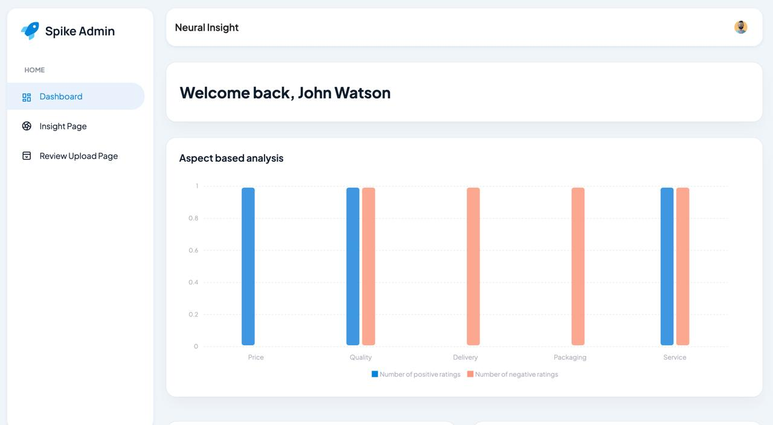

RESULTS
Insights: The owner can identify the reasons behind the product's performance, whether good or bad, and take appropriate actions to improve it.
DEMO
Show how the dashboard works:

Slide 20

DATA PROCESSING PIPELINE (Outline)
Data Collection and Preparation.
Exploratory Data Analysis.
Model Selection and Training.
Evaluation.

Slide 21
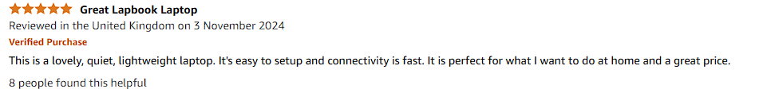
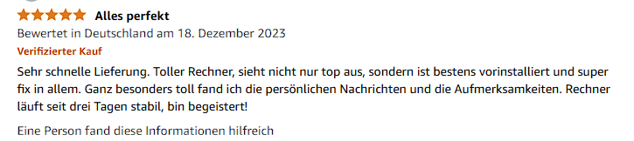

DATA COLLECTION AND PREPARATION
Sources: Sample demo data for Amazon reviews.

Slide 22
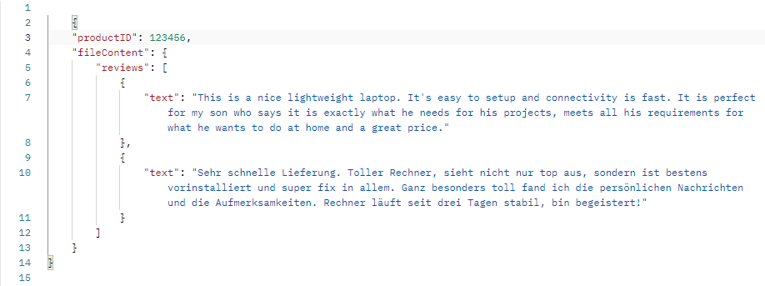
DATA COLLECTION AND PREPARATION
Data Format: Text reviews containing aspects of service, quality, price, delivery and packaging.
Frontend

Slide 23
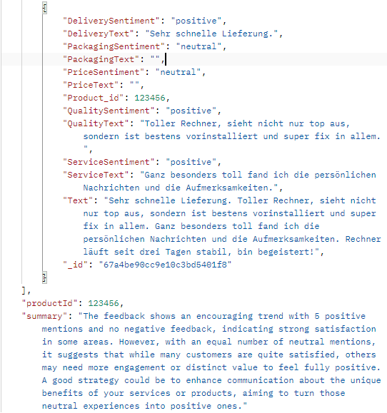
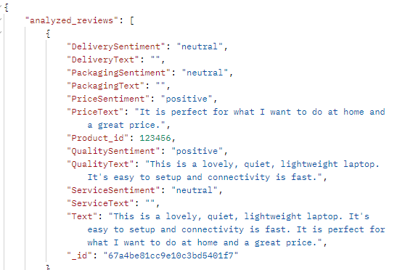
DATA COLLECTION AND PREPARATION
Data Format: Text reviews containing aspects of service, quality, price, delivery and packaging.
Backend

Slide 24
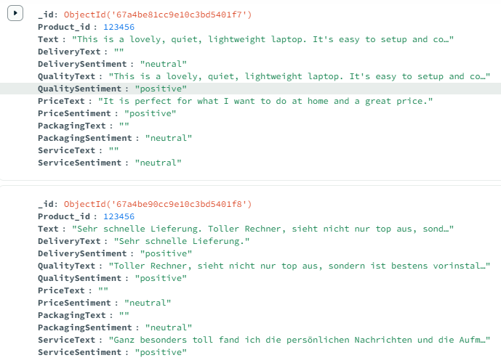
DATA COLLECTION AND PREPARATION
Data Format: Text reviews containing aspects of service, quality, price, delivery and packaging.
Database

Slide 25
DATA COLLECTION AND PREPARATION
Why don’t we need traditional feature engineering and data cleaning?
GPT-4o can directly understand and analyze natural language, so you only need to ensure that the data is correctly formatted (e.g., as JSON).
Data Collection
Data Formatting
Data Analysis

Slide 26
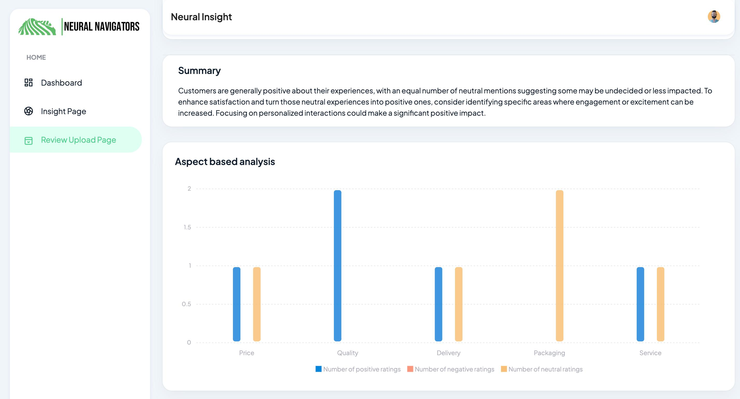

EXPLORATORY DATA ANALYSIS
Analysis Focus:
Distribution of positive vs. negative reviews.
Sentiment correlation with aspects like price and delivery.

Slide 27
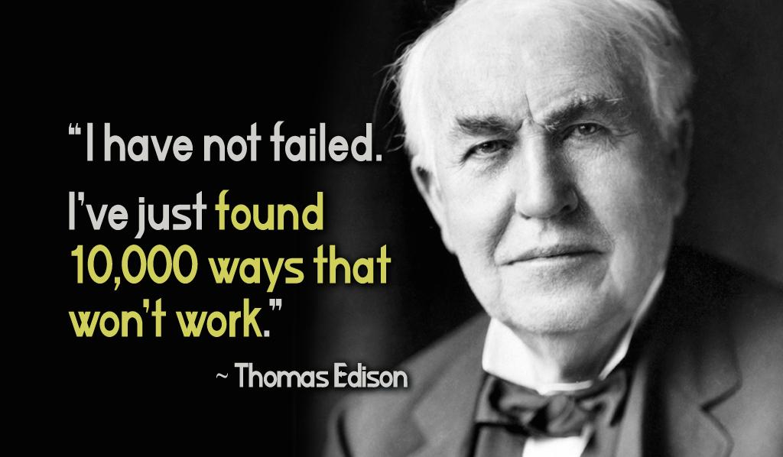

MODEL SELECTION
Chosen Model: GPT-4o.
Advantages: High accuracy for sentiment classification.
Constraints: Balancing cost and efficiency.
MODEL TRAINING

Slide 28
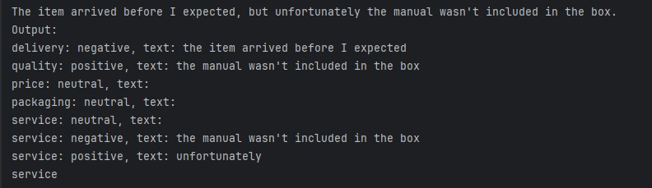
Performance Comparison Between GPT-2 and GPT-4o
Wrong！
GPT2

Slide 29
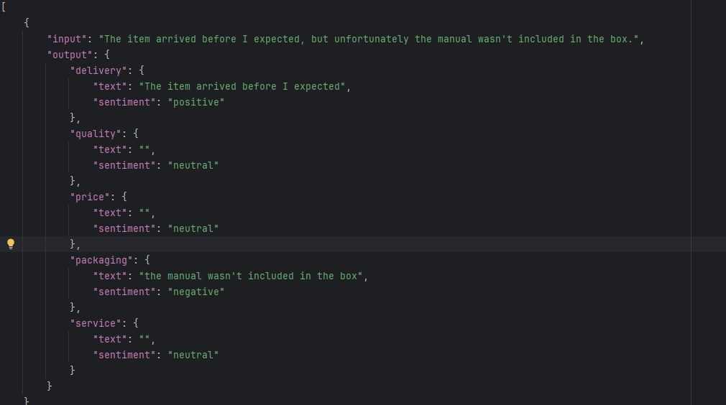
Performance Comparison Between GPT-2 and GPT-4o
GPT4o

Slide 30
EVALUATION
Task: Perform multi-dimensional sentiment analysis on text reviews (e.g., delivery, quality, price, packaging, service).
Method:
GPT-2: Classification achieved through fine-tuning.
GPT-4o: Direct analysis via prompt engineering, without additional training.
100 reviews with right sentiment tags and text.

Slide 31
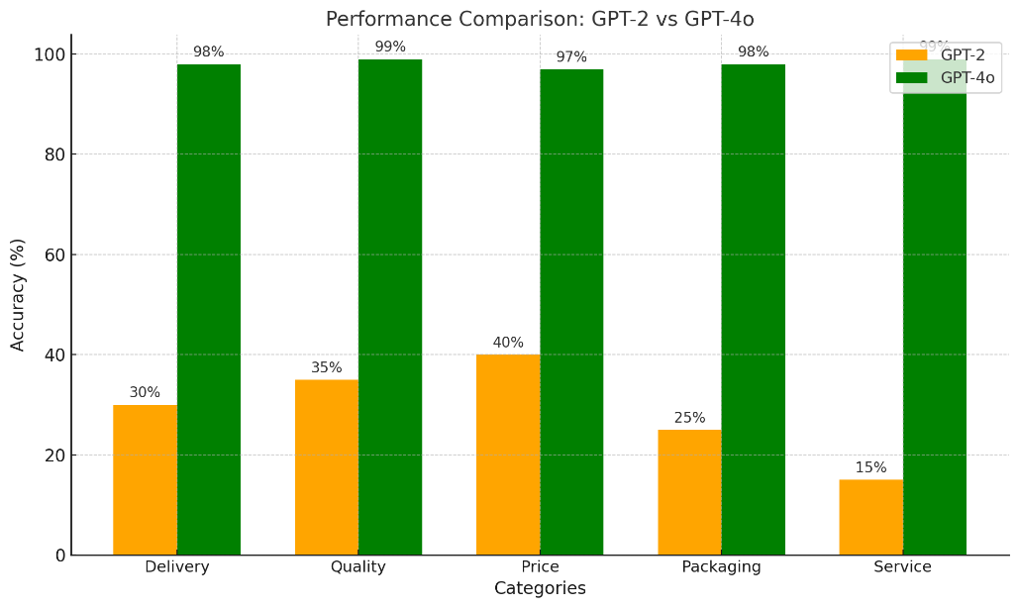

EVALUATION
Conclusion:GPT-4o outperforms GPT-2 with higher accuracy and better context understanding, making it ideal for multi-dimensional sentiment analysis.
GPT4o
GPT2

Slide 32

CHALLENGES
Limited aspects.
Cost of advanced models.
Lack of good open source model.
CONSTRAINTS
Model Cost: Budget limitations for paid tools/models and hardware models.

Slide 33

FUTURE IMPROVEMENTS
Cover more aspects.
Add multilingual support.
Integrate live sentiment updates.
Explore cost-effective model alternatives.

Slide 34

LESSONS LEARNED
Challenges of balancing cost and model efficiency.
Model Selection and Fine Tuning
Team Work

Slide 35

THANK YOU!
Thank you for your attention!

